Slide 1
EFEE involvement for individual and corperate members
Election of individual and cooperate delegates with voting rights .

Slide 2
Organization and voting
General Assembly
Council
National associations delegates
Corporate members - 4 delegates
Individual members - 2 delegates
Newsletter Committee
Constitution Committee
Secretariat
Secretary General
Environmental Committee
Conference Committee
Board
President
Vice President
Immediate Past President
Treasurer
Board members
EU Directives Committee
Marketing & Membership
Election Committee
Shotfiring Committee
Committees
Chairman
committee members
Finance and Audit Committee

Slide 3
Facts
European Federation of Explosive Engineers
Founded in 1988
25 National Members from 24 Countries
International Coverage through National Members estimated to reach 80,000 Shotfirers
Provides a European Forum for professionals
Supporting research and education
Cooperation with ISEE, FEEM, SAFEX, EDA, EU and other bodies
EFEE World conference on Explosives and Blasting
Newsletter, sent out 3 or more times a year

Slide 4
Primary objective of EFEE
The primary objectives of EFEE is the development of good practise, harmonisation of rules and regulations in Europe for the use of explosives in the civil sector.
The training of staff and labour is of utmost importance with a focus on the required qualifications and training programmes of the shortfirer.

Slide 5
Other objective include
Promotion of safety, health, environment and security in the field of explosives
Promotion, standardisation and harmonisation of explosives training in Europe
Promotion of explosives technology in all fields related to this technology
The fostering of the image of the profession as well as good relations and cooperation with related associations
Collaboration on the development of laws and regulations within the EFEE field of activities

Slide 6
EU listens to EFEE
Active cooperation with EU working bodies e.g. meetings of explosives working group and meetings of Notified bodies for explosives.
Transfer the response from EFEE members to the EU working bodies on how the new directives and regulations are operated and used.
Gather, communicate and advocate the initiatives, ideas and goals coming from EFEE members to EU working bodies

Slide 7
The development of EFEE
National Members have an automatic right to nominate one voting member per country.
There is now the oportunity for Corporate (or Company) Members to elect up to 4 voting representives from amongst themselves.
Individual Members can elect up to 2 voting representives.
All members of Council are eligible to stand as Board Members and ultimately as President of EFEE.

Slide 8
Come and make a difference
EFEE represents you, most of the national nominated representatives are working for explosive companies, but you should be thinking about the benefits of being a council member.
However the EFEE council really want to benefit from more input from the companies and individuals who do pay to be members.

Slide 9
Meetings to attend
The council meets twice a year with committee meetings on the Friday, where the work is done prior to the Council meeting for ratification on the Saturday.
Members normally fly in on Thursday and out Sunday.
All attendees pay their own expenses for council meetings or in many cases their company does as it is an important work related event.
EFEE pays for travel and accommodation for Board representatives for the two additional Board meetings held between Council meetings in summer and winter.

Slide 10
Benefits for the member
Influence on EFEE policies regarding explosives usage in Europe.
First hand information and reports of developments in other countries and the sector as a general.
Direct influence on EFEE input into the EU regulatoratory authorities.
Be part of great network in the explosive sector with professionals from a wide range of countries and backgrounds
Travel the European map of blasting; the EFEE meetings are hosted by National Organisation.

Slide 11
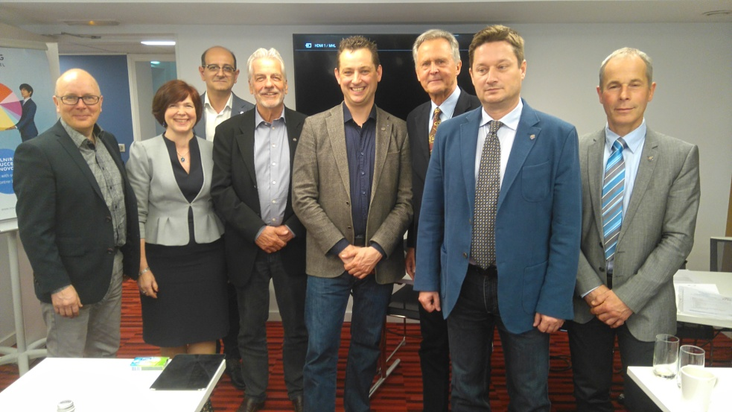
Looking forward to see you

